Slide 1
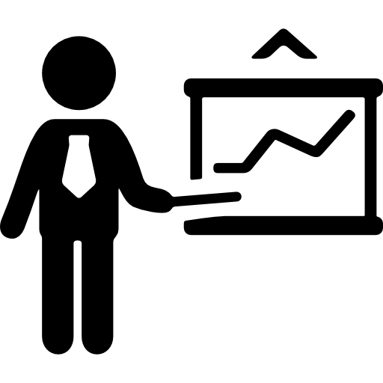
Tech Consulting: TCG x DS3
Consulting Subcommittee
Aishani Mohapatra
Qiaoxuan (Josh) Wang

Slide 2
Background
- What is Data Science & Consulting?
- How is Data Science useful in Business?
Applications
Tools & Examples
Q&A

Slide 3
[01] Background

Slide 4

What is Data Science & Consulting?
Consulting is a term loosely applied to providing business advice on various topics including marketing, information technology, operational improvement, and corporate strategy
Data Science revolves around revealing trends and creating intelligence that organizations can use to make smart and better decisions, predict change, and of course, create more innovative services and products
Consulting allows you to take initiative for client development and results
Find a problem in the data, infrastructure, etc and propose solution(s)
Source: https://towardsdatascience.com/why-working-in-consulting-is-so-valuable-for-data-scientists-710f3a4cc2d0
Notes:
Talk about tcg projects/?

Slide 5
How is Data Science useful in Business?
Directs Actions based on trends which in turn helps define goals
data scientists examine and explore organizations’ data, after which they recommend and prescribe certain actions that will help improve the institution's performance, better engage customers, and ultimately increase profitability.
Data science + business practices = a huge difference in productivity, decision-making, and product development.
Data helps inform decisions that minimize the risk of fraud and error, increase efficiency, and provide better customer service

Slide 6
[02] Applications

Slide 7
Gaining Customer Insight
Data about your customers (all with different characteristics) can reveal details about their:
Habits
Demographics
Preferences
Having and understanding reliable customer data can inform:
Retargeting efforts
Personalized experiences for specific users
Improvements to website and product’s user experience.
Pattern recognition in e-commerce helps spot trends in customer purchasing behavior.

Slide 8
Predicting Future Market Trends & Developing Better Product
Collecting and analyzing data on a larger scale can enable you to identify emerging trends in your market.
To find what products people are interested in, we can track:
purchase data
celebrities and influencers
search engine queries

Slide 9
Streamline Processes
First step is to measure performance through data collection to make educated decisions by using trends and empirical evidence to help produce solutions.
Data can enable the company to grow and take on more load by increasing the efficiency of daily operations and work volume.
With data collection, a business can allow for testing and measuring different methods and feedback from workplace operations.
Identify inefficiencies, like high data volume for manual analysis
algorithm can be written to clean, sort, and interpret it quickly and accurately to gather insights

Slide 10
Inform Internal Finances and Security
Data science in a business can be used to:
Create reports
Generate forecasts
Analyze financial trends.
Data on a company’s cash flows, assets, and debts are constantly gathered, which financial analysts can use to manually or algorithmically detect trends in financial growth or decline.
Protect sensitive information and increase the security of the business

Slide 11
[03] Tools & Examples

Slide 12
PowerBI
PowerBI is a popular business analytics service by Microsoft
Aims to provide interactive visualizations and business intelligence capabilities with an interface simple enough for end-users to create reports and dashboards
Allows non-technical users to create customized dashboards
Source: https://learn.microsoft.com/en-us/power-bi/create-reports/sample-datasets

Slide 13
Tableau
Similar to PowerBI, Tableau is a powerful and fast growing data visualization tool used in the Business Intelligence Industry.
It helps in simplifying raw data in a very easily understandable format. Tableau helps create the data that can be understood by professionals at any level in an organization.
Has advanced settings for handling more complex or larger volumes of data faster than PowerBI and other data vis applications

Slide 14
Consulting Project Opportunities
In DS3, Triton Consulting Group (TCG), and Cornerstone Community Consulting (CCC) there are plenty of projects like these for you all to work on
In these clubs and committees, you’ll have opportunities to take advantage of the technical skills you’ve learned and built through your coursework and apply them to business contexts and help solve
Over the next few slides, I’ll talk about some of my experience working on and leading one of these projects over the past few quarters

Slide 15
Frontier Dental Services (FDS)
Project Focus: Use revenue data to analyze client engagement, understand revenue trends, and compare lab performances
Project Goal: Generating key revenue insights to help Frontier Dental Superholdings (FDS) maintain and expand their client base
Task 1
Task 2
Use predictive analytics focused on the churned clients. Key Performance Indicators (KPIs) were identified to predict which dentists were most likely to leave FDS, including product prices, time between purchases, average revenue. Additional improvements were made to the robustness of the algorithm.
Use PowerBI to conduct data analysis and visualization of dental clinic performance. Dashboards will segment the client-base, providing us with insights on customer purchasing patterns. Additionally, create dashboards to compare performance across several labs to understand their best-selling products and identify important customers.

Slide 16
[04] Q&A

Slide 17







Find us on social media!
@DS3UCSD
@DS3UCSD
Thank you!
Th
@DS3.UCSD
https://tinyurl.com/discordds3
ds3.ucsd.edu
ds3@ucsd.edu
Notes:
GBM is planned for next Thursday (September 24) at 6pm where all the Directors and PVP will be presenting for their respective organizations
How can I get involved? We are recruiting for most subcommittees
Active Community on Discord
People come from various backgrounds (check website for where we have interned, advice/tips), tutoring, HDSI Research Scholarship, professors, research at Qualcomm Institute, etc.
Opportunities, class questions, etc.
Tabling tomorrow! And next Tuesday (Library Walk) and Wednesday (EOTG), additionally we will be speaking at DSC classes either this week or next, etc.

